Slide 1

G2M Case Study
Virtual Internship Submitted By: kumkum Chakraborty Date: Jan/14/2025

Slide 2
DATA INFORMATION
Cab_Data.csv – this file includes details of transaction for 2 cab companies
Customer_ID.csv – this is a mapping table that contains a unique identifier which links the customer’s demographic details
Transaction_ID.csv – this is a mapping table that contains transaction to customer mapping and payment mode
City.csv – this file contains list of US cities, their population and number of cab users

Slide 3
G2M(cab industry) case study XYZ is a private equity firm in US. Due to remarkable growth in the Cab Industry in last few years and multiple key players in the market, it is planning for an investment in Cab industry. Objective : Provide actionable insights to help XYZ firm in identifying the right company for making investment. The analysis has been divided into four parts: 1.Data Understanding 2.Forecasting profit and number of rides for each cab type 3.Finding the most profitable Cab company 4.Recommendations for investment

Slide 4
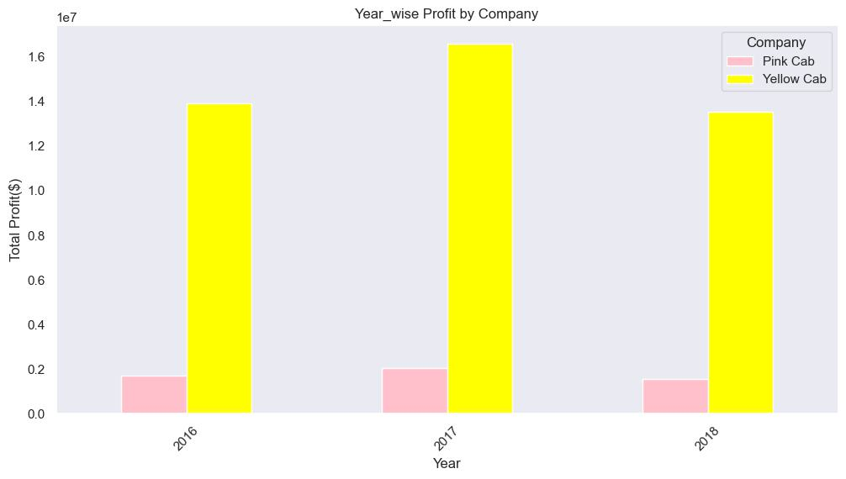
YEAR WISE PROFIT
This graph showing that 2017 is more profitable for both cab

Slide 5
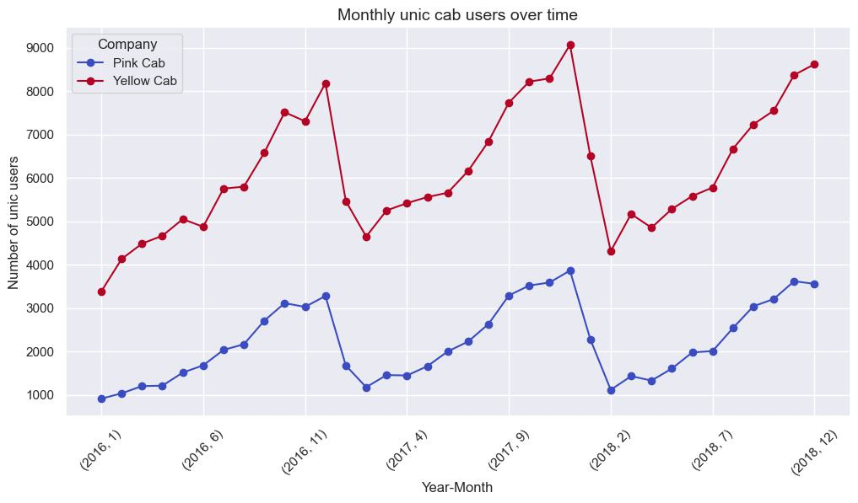
Which company has maximum cab users at a particular time period?
We can see yellow cab users getting higher over time

Slide 6
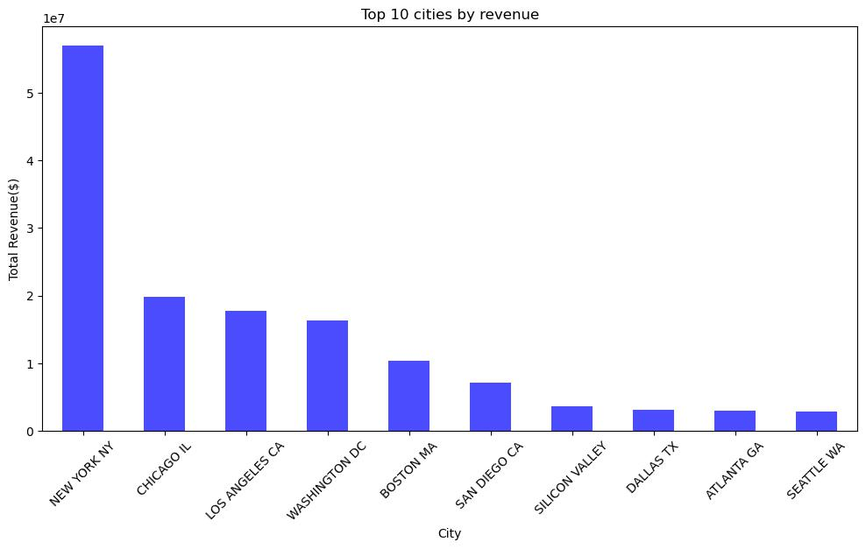

Slide 7
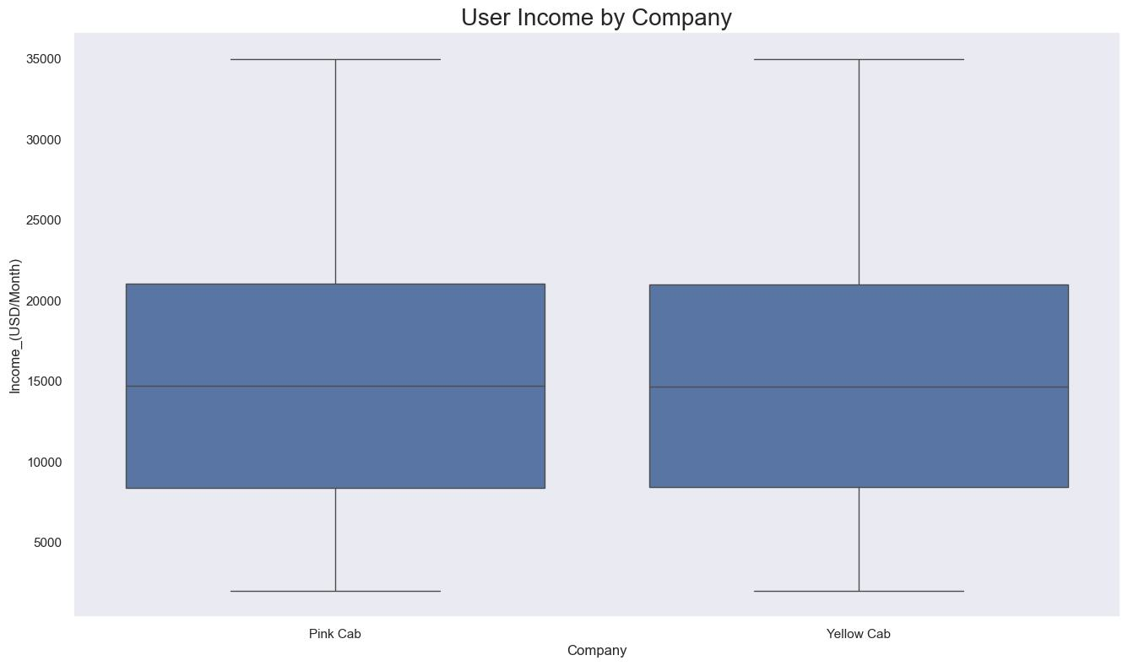
User’s Monthly Income
We can see user monthly income is $15k

Slide 8
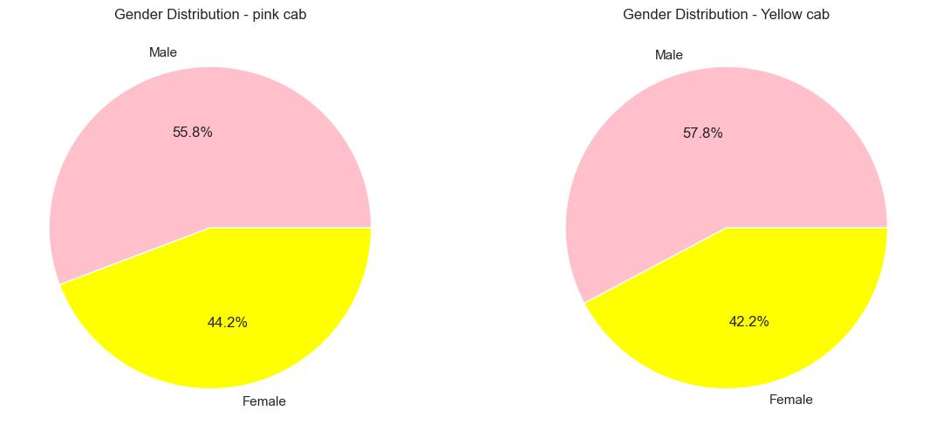
Gender Distribution for both company
Male users is more than female for both company

Slide 9
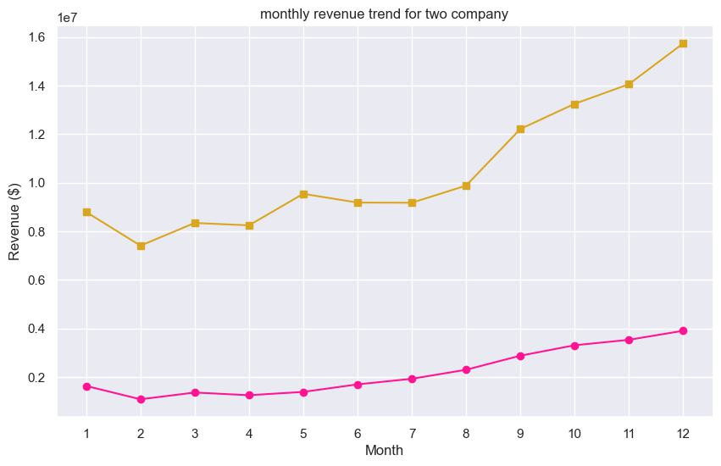
Monthly Revenue Comparison
Monthly revenue is in yellow cab

Slide 10
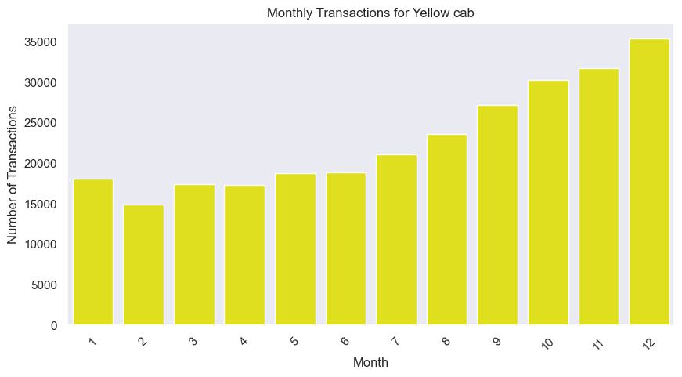
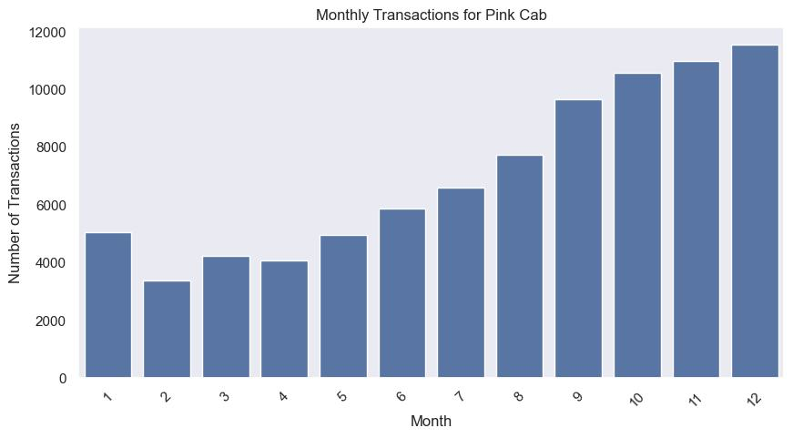
Monthly Transaction Pink Cab
Monthly transacting is higher from September to December for both company

Slide 11
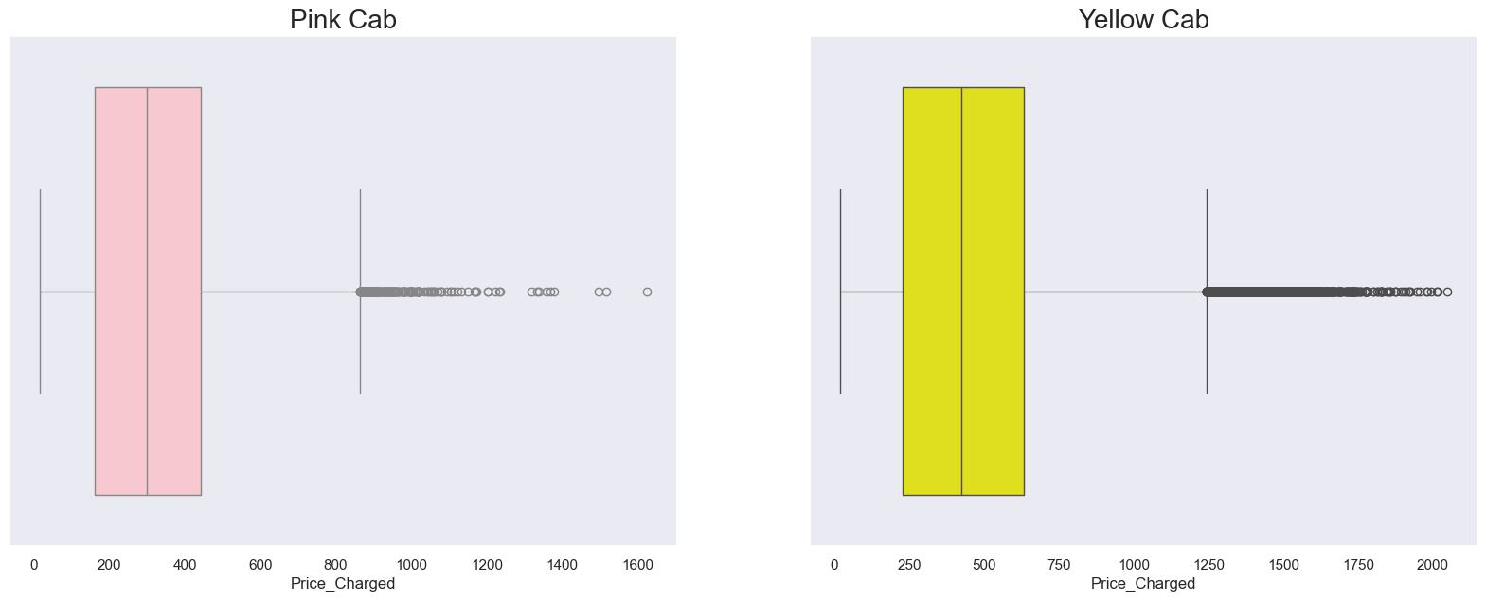
Distribution of Price Charged for Both Cabs
1.Price charged range for yellow cab is more than pink cab
2.Outlier is due to high end car

Slide 12
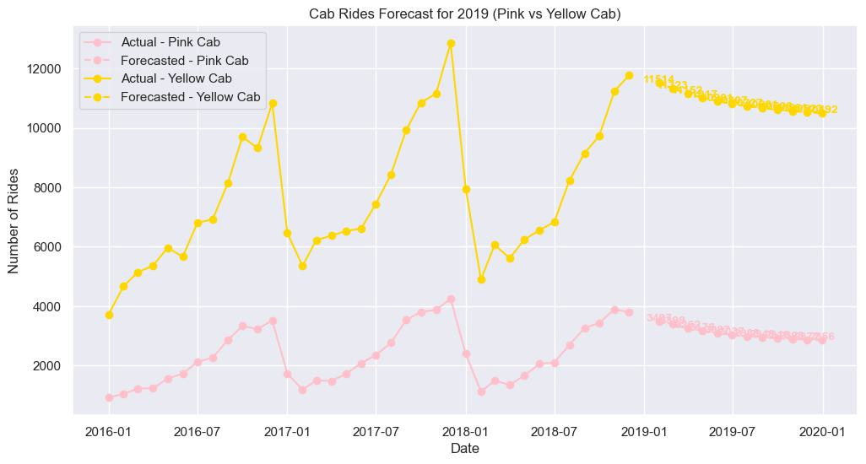
Forecasting for 2019

Slide 13
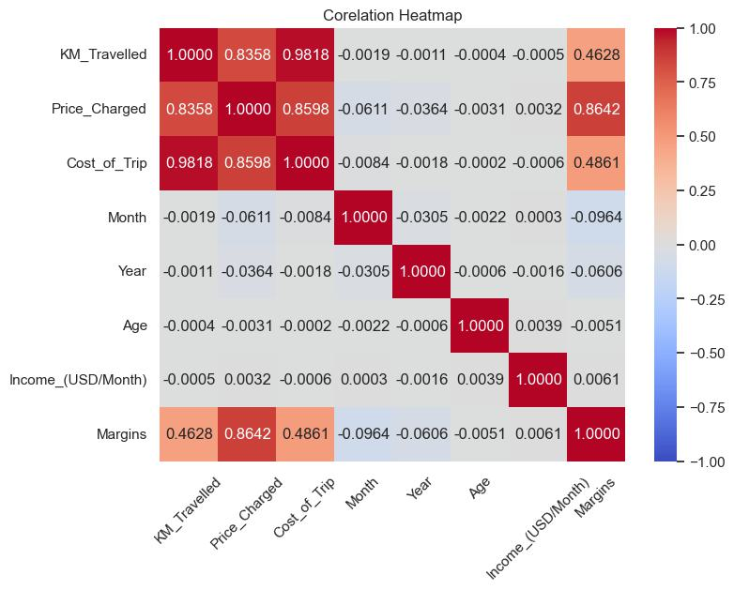
CORELATION HEATMAP

Slide 14
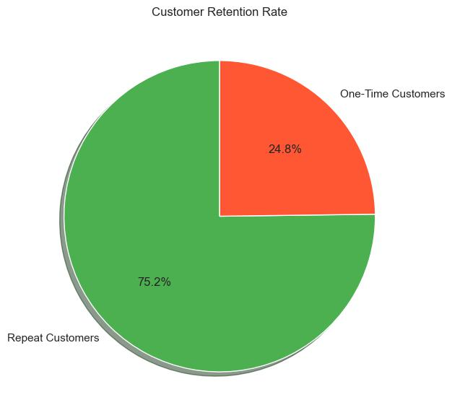
Repeat customer is high

Slide 15
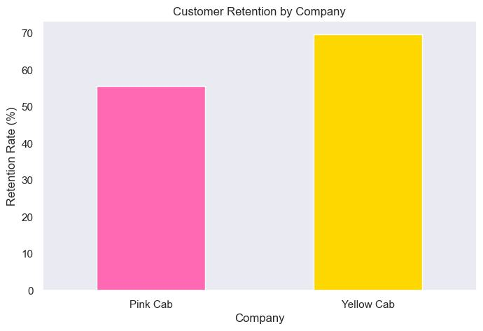
Yellow cab retention is higher than pink cab

Slide 16
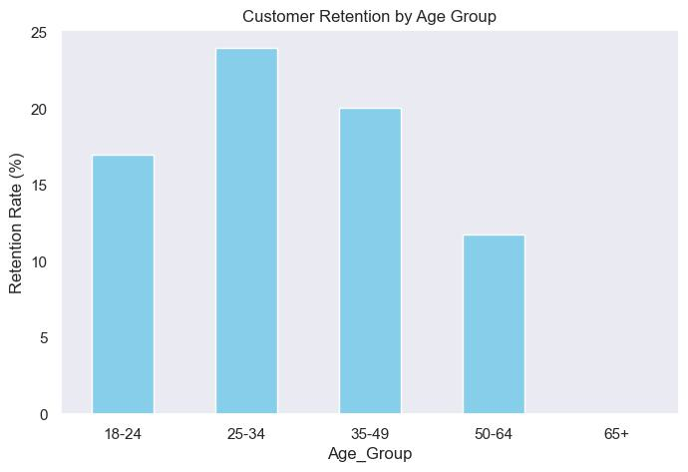
From this graph, we can see age group between 25to 34 retention is higher than others group

Slide 17
Recommendations:
Customer Reach:
Yellow cab users is higher than pink cab and 2017 was more profitable year for both company.
Customer Retention:
Yellow cab retention is better than pink cab, 25–34-year age group’s retention is high.
Yellow cab’s average profit per KM is almost three times than average profit per KM of the Pink cab.
Average Profit per km:
We see that customers prefer to use cab mostly September to December
User Time:
Ride count and Profit Forecasting:
Both companies are facing loss in the profit and no. of ride. Yellow cab’s forecasted profit
New York city making more revenue than others city
City users:
On the basis from above point ,We recommend to invest for yellow cab.

Slide 18
THANK YOU

